Slide 1


Slide 2

1.Building key infrastructure to grow our region - in partnership with government, community and regional business
2. Pipeline projects, master planning and working towards 2040
3. Importance of ‘soft infrastructure’

Slide 5
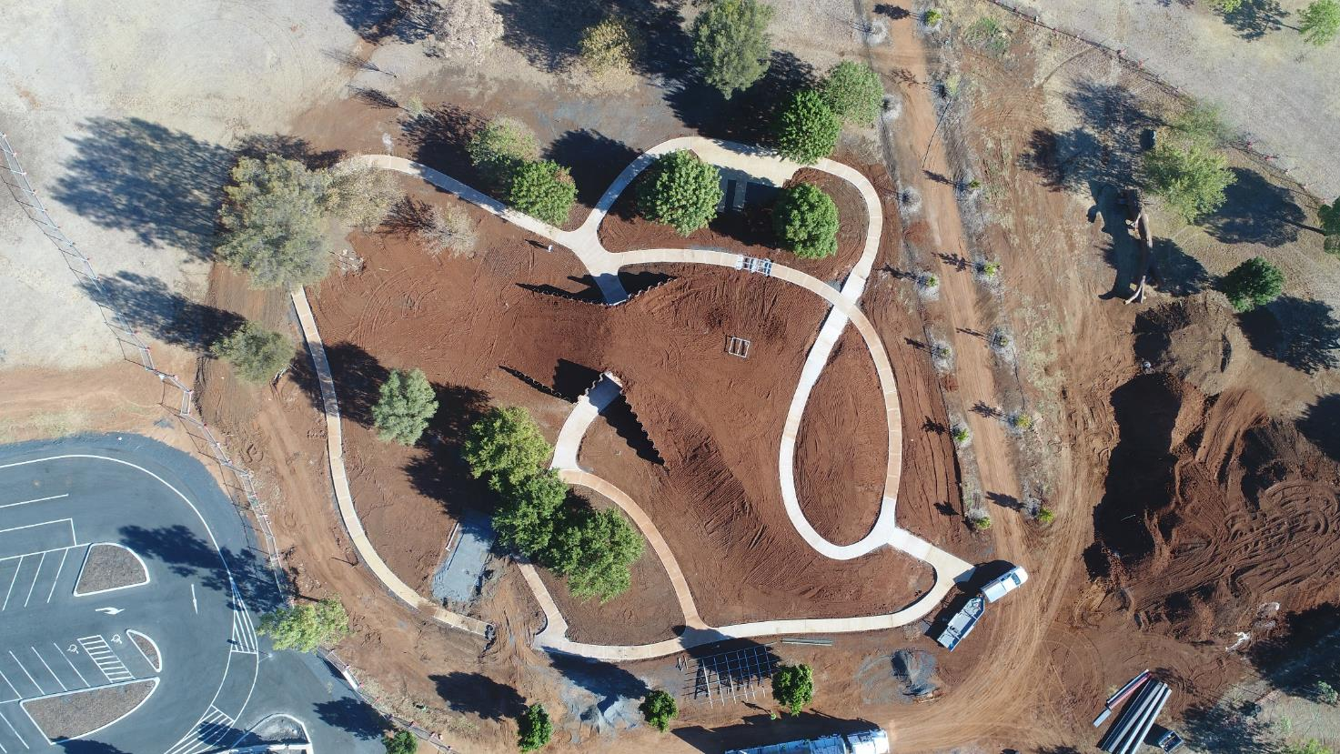
Stronger Communities Fund - NSW

Slide 6
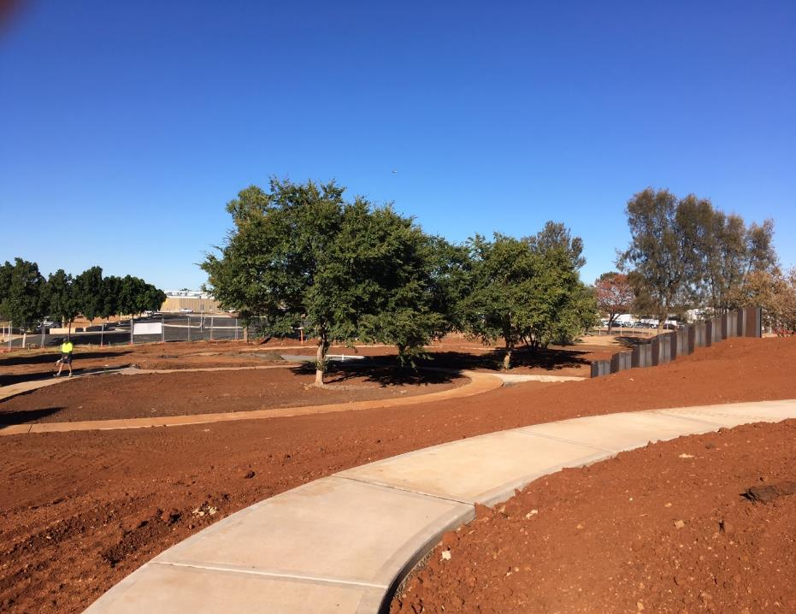
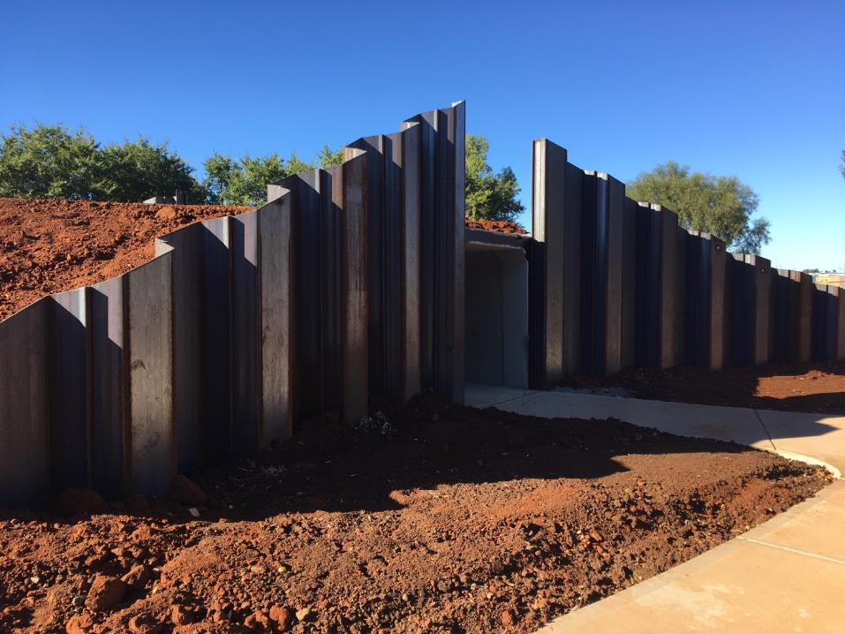
Regional Playground and Carpark.
Dubbo Regional Botanic Garden

Slide 9
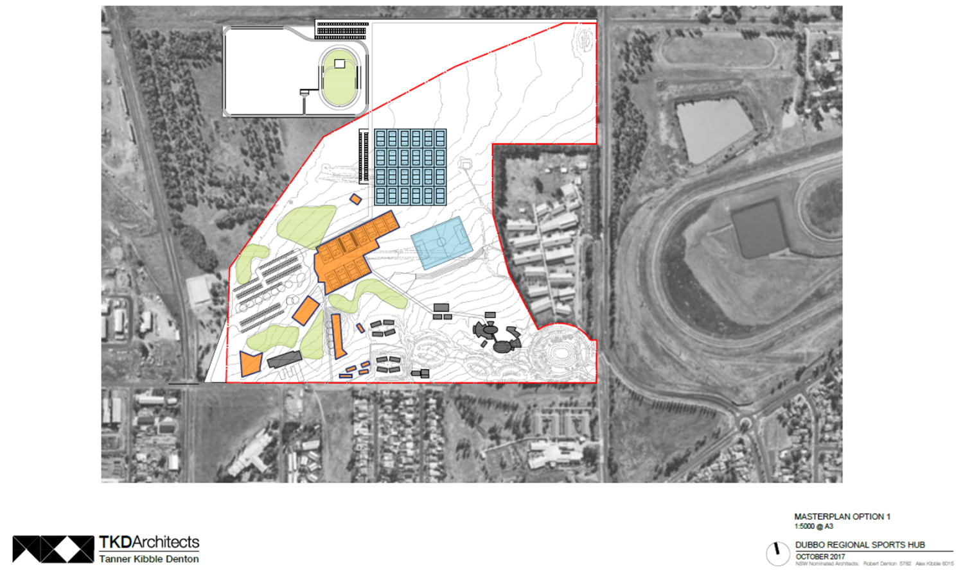
Dubbo Regional Sports Hub

Slide 10
What is the Regional Sports Hub?
Indoor Sporting/ Health/ Education precinct based at the CSU campus and adjacent Council recreational land.
Multi-sport indoor centre
Regional PCYC Hub – they shall own and operate whole facility
Administration site for the NSW Office for Sport and associated development officers.
Capability to host regional/ state and national championships
Currently seeking funding from:
Regional Sports Infrastructure Fund (NSW)
Growing Local Economies Fund (NSW)
Building Better Regions Fund (Aust)

Slide 11
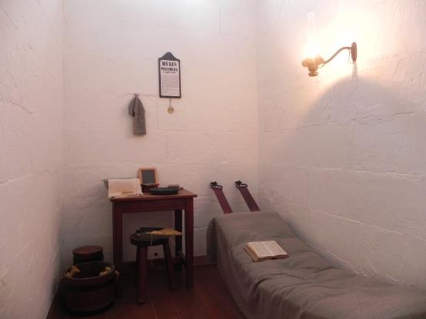
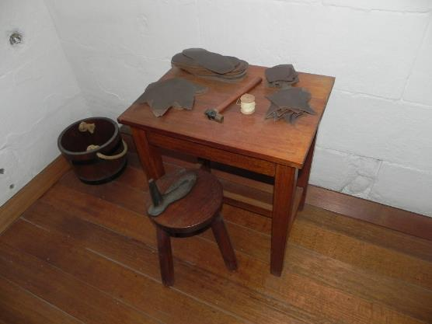
Old Dubbo Gaol Concept Plan
Sample Cell Treatments
A plan has been developed to bring Old Dubbo Gaol into the future with exciting interactive exhibits designed to enhance visitor experience.
This $1.3M project will include exhibits such as digital projections and sound recordings that will give visitors a taste of prisoner life, set amongst a revitalised and refurbished facility incorporating the existing State Heritage Listed buildings.
To make these plans a reality, Council is seeking $600,000 in funding from the Regional Cultural Fund

Slide 12
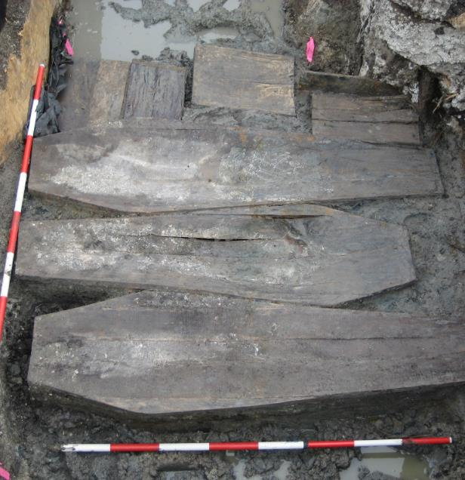
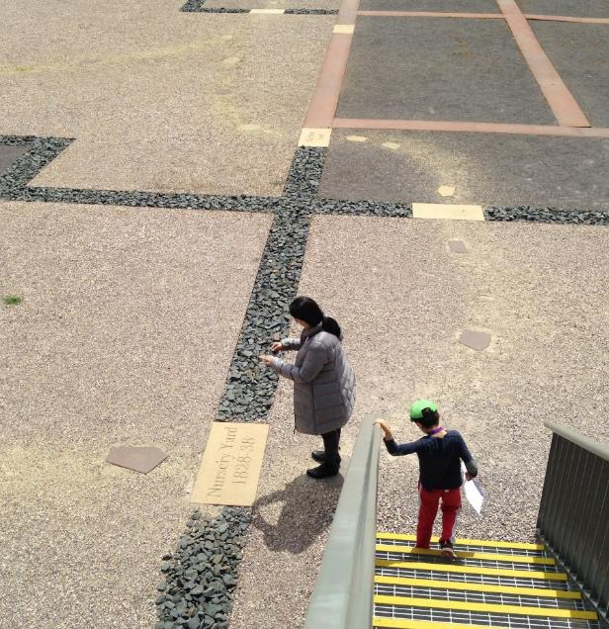
Old Dubbo Gaol Concept Plan
Sample Interpretive Artworks

Slide 13


Industry capability /facilitation / work packaging
Agriculture industry development
Skill pipeline study
Skill attraction support
Destination Partnership Program
Great Business Program
Regional Economic Development Strategy

